Slide 1
Welcome to Arabic Level I by Kurzban

Slide 2
Lesson 19:
Objectives:
Review
Conversational
Arab States: Identifying and inquiring about Arab countries, capitals, and cities
Practice
Summary
Flash card

Slide 3
Do Now: Review
Combine the letters in each set.
د+ل+ا+ل=
ت+ن+ك+ط=
ي+س+ش+ز=
و+ه+ع+ف+ص=

Slide 4
Provide words or phrases to answer or question the right hand column
كَيفَ الحال؟
مع السلا مة
مَرحَباً
مصر
انتَ
لا
إسمي زيْنية؟

Slide 5
Lesson 19
Review.
Where? أيْنَ؟
When? مَتَى؟
Why? لِماذا؟
In what? In Which? (m./f.) فِي أيِّ؟ أيَّةِ؟

Slide 6
Lesson 19: Focus on Haa, lam and Mim
بَ+ه+ل+و+لْ=
ا+ل+مَ+ل+ا+هِ+ي=
سَ+ف+ي+ه=
فِ+د+ا+ه=
مُ+ه+ا+تَ+ر+ا+ت=

Slide 7
Lesson 19:
Describing one’s national regional affiliation involves providing information about one’s place of origin or residence. This function requires the use of a noun called :noun of nisba”.

Slide 8
Lesson 19:
انا مِصْريّ
هُوِ مِنْ مَدِينَة الْقَاهِرَة

Slide 9
The relative Noun Nisba
The noun used to indicate affiliation is called a relative: “noun.”The Arabic word for it is nisba (relation). It is derived form a noun that refers to a city, country, region, ethnic group, etc. This process is fairly simple.
It involves adding one suffix to nouns ya with shadda.

Slide 10
Lesson 19:
Egyptian:________________________مصر
Now say, he is from Egypt:
____________________________
Tunisian: ______________________تونِس

Slide 11
If a noun ends with a ta marbuta or alif, drop them and add yaa
French: فَرَنْسا ________>فَرَنسيّ

Slide 12
Lesson 19
If a noun ends with ya and ta marbuta or ya and alif, drop the ta marbuta or alif and attach ya which will make a doubled ya with original one.
Syrian
سورية ___________>سوريّ

Slide 13
Your turn:
مَغْرِب____________
لُبْنان___________

Slide 14
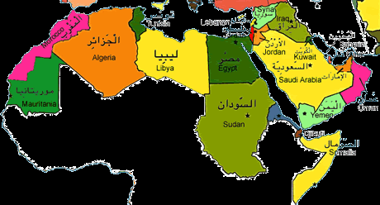
Lesson 19: Inquiring about and identifying Arabic Cities
The map below displays some of the names and locations of some Arab cities.

Slide 15
Lesson 19
For practice, ask your partner where certain town is located and answer the question using the name of that city and the country.
Here is an example:
أينَ بَغْداد؟
بَغْداد في العراق

Slide 16
Lesson 15: Inquiring about and identifying Arabic Cities
You might need to learn about capital cities of some Arab countries in order to finish this exercise.
Capital Country
المغرب الرباط
مصر القاهرة
لبنان بيروت

Slide 17
Review
Review
Make your flash card for this lesson
Questions????

Slide 19
1) Pick an Arab country: 2) List the neighboring countries 3) List the population 4) Main source of economy 5) Date of Independence 6)Other spoken languages 7) Most common dishes 8) What is an Arab? 9) What does an Arab look like?

